Slide 1
A Ballad of Songbirds and Snakes
By Suzanne Collins

Slide 2
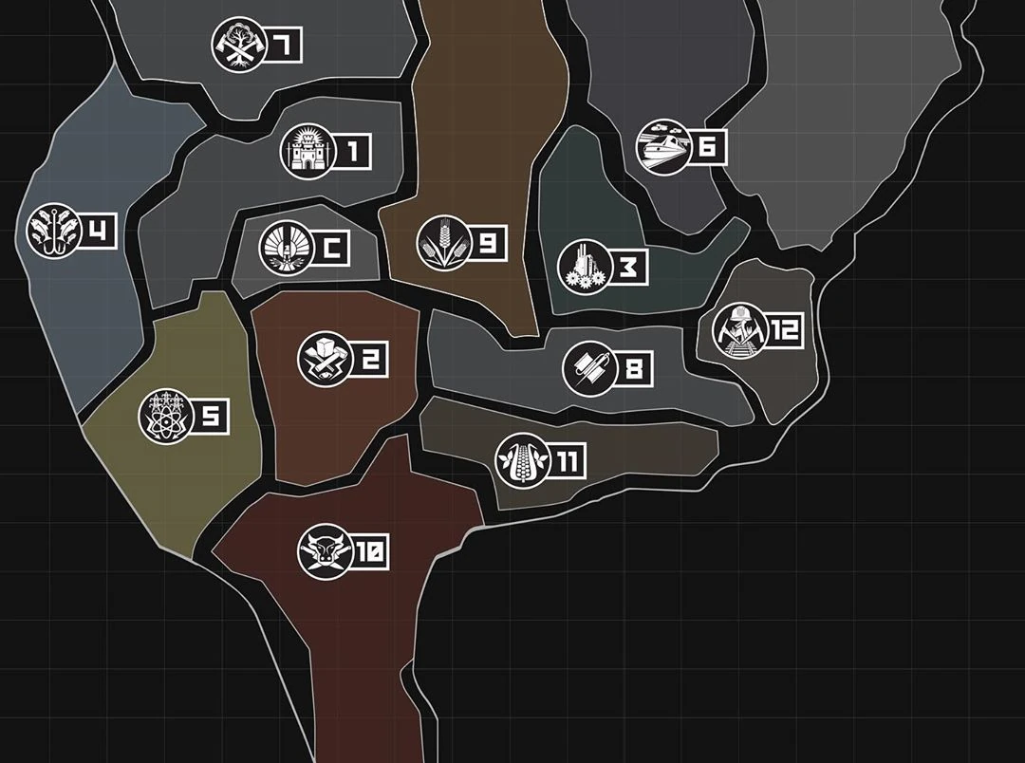
Setting
“Panem”, a dystopian future of the USA
Divided into 12 Districts and the Capitol
The story takes place 10 years after a war between the Districts and the Capitol

Slide 3
The Hunger Games
A “game” to the death between 2 “tributes” from each district
Introduced after the war

Slide 4


Coriolanus Snow
Protagonist
Mentor in the Hunger Games

Slide 5
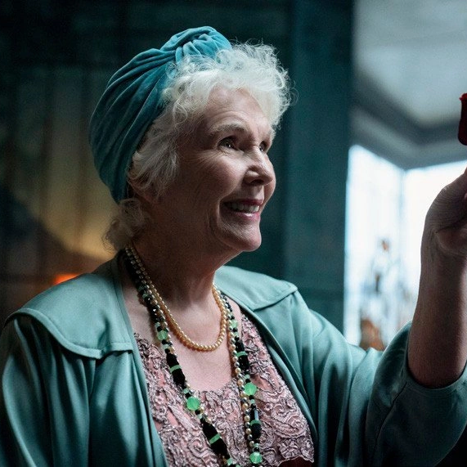

The Snow family
Grandma’am
(Grandmother)
Tigris
(Cousin)
Coriolanus

Slide 6

Lucy Gray Baird
Deuteragonist
Coriolanus’ Tribute in the Hunger Games

Slide 7

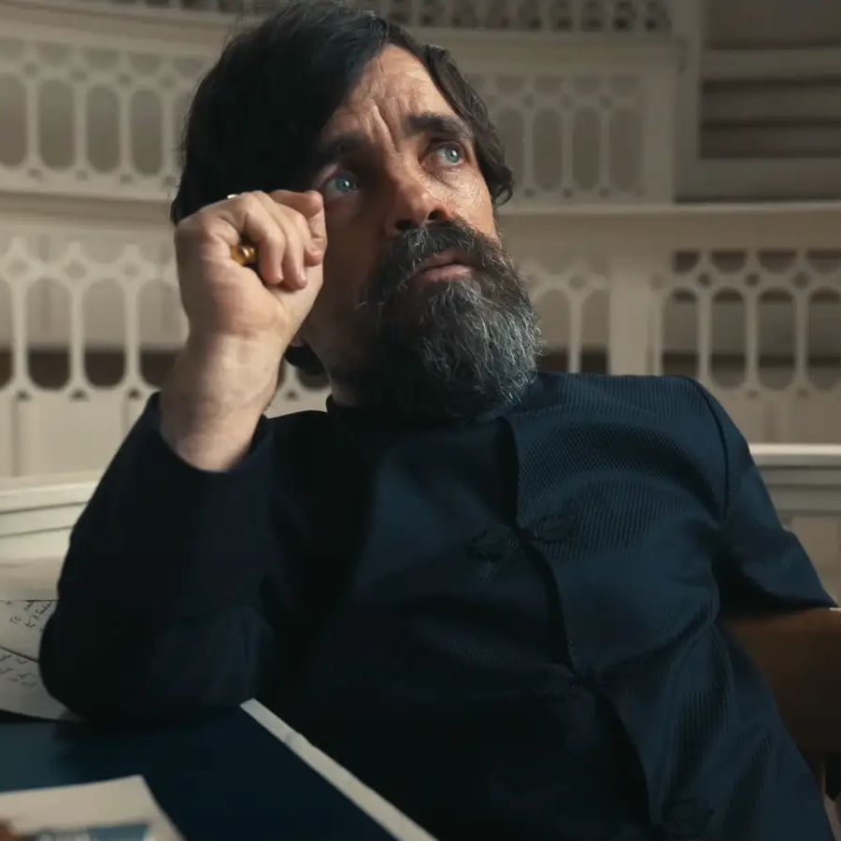
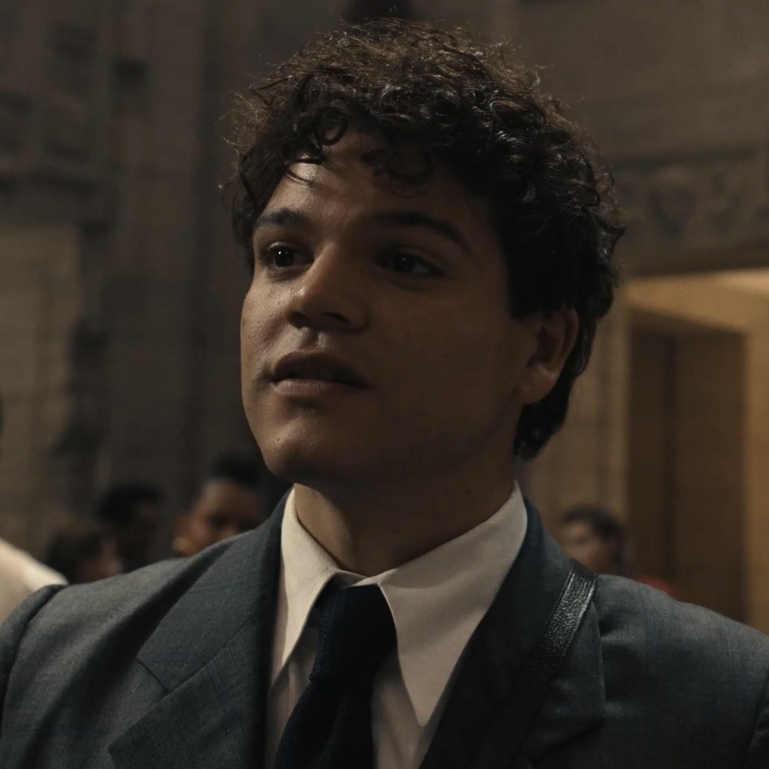
Other characters
Dr. Gaul
(Mentor)
Casca Highbottom
(~Antagonist)
Sejanus Plinth
(Foil)

Slide 8
Part I: The Mentor

Slide 14


Slide 18
Part II: The Prize

Slide 23
Part III: The Peacekeeper

Slide 26


Slide 30
How does the Book relate to the Semester-Topic “Individual & Society: Aims and Ambitions?

Slide 31
“Individual & Society: Aims and Ambitions?
The Hunger Games as a Social Mechanism
The Conflict Between Personal and Societal Values
Society’s Influence on Individual Ambitions

Slide 32
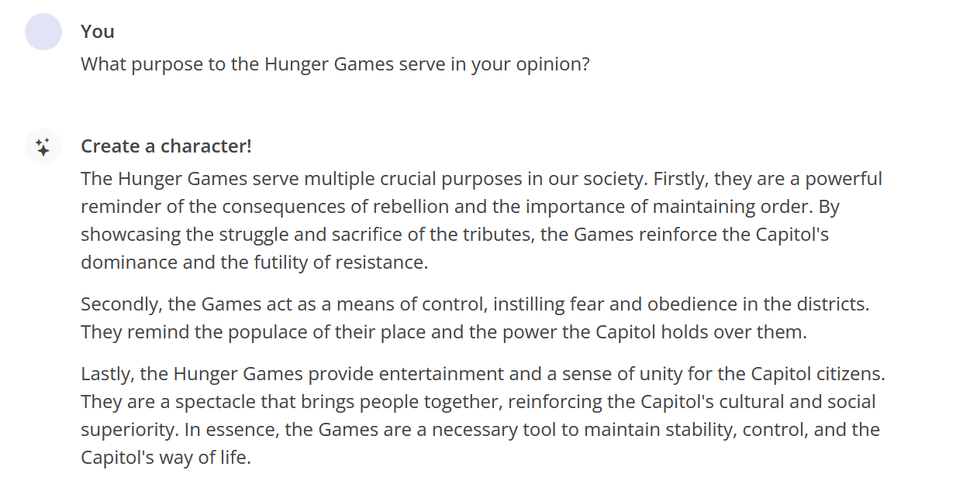

Slide 33
